Slide 1
Week 4 Recap

Slide 2

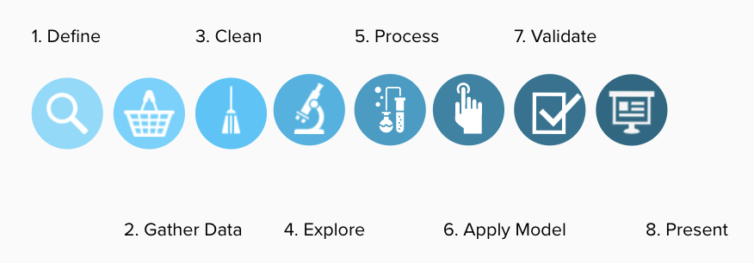
DATA ANALYTICS
DATA ANALYSIS PROCESS

Slide 3

IRONHACK BOOTCAMP
TYPES OF
DATA ANALYSIS
Descriptive
Diagnostic
Predictive
Prescriptive
Summarize existing data to get a picture of what has happened or is happening
Uncovering the root cause of events
Forecast possibilities in the future
Analyzing and recommending the best actions

Slide 4
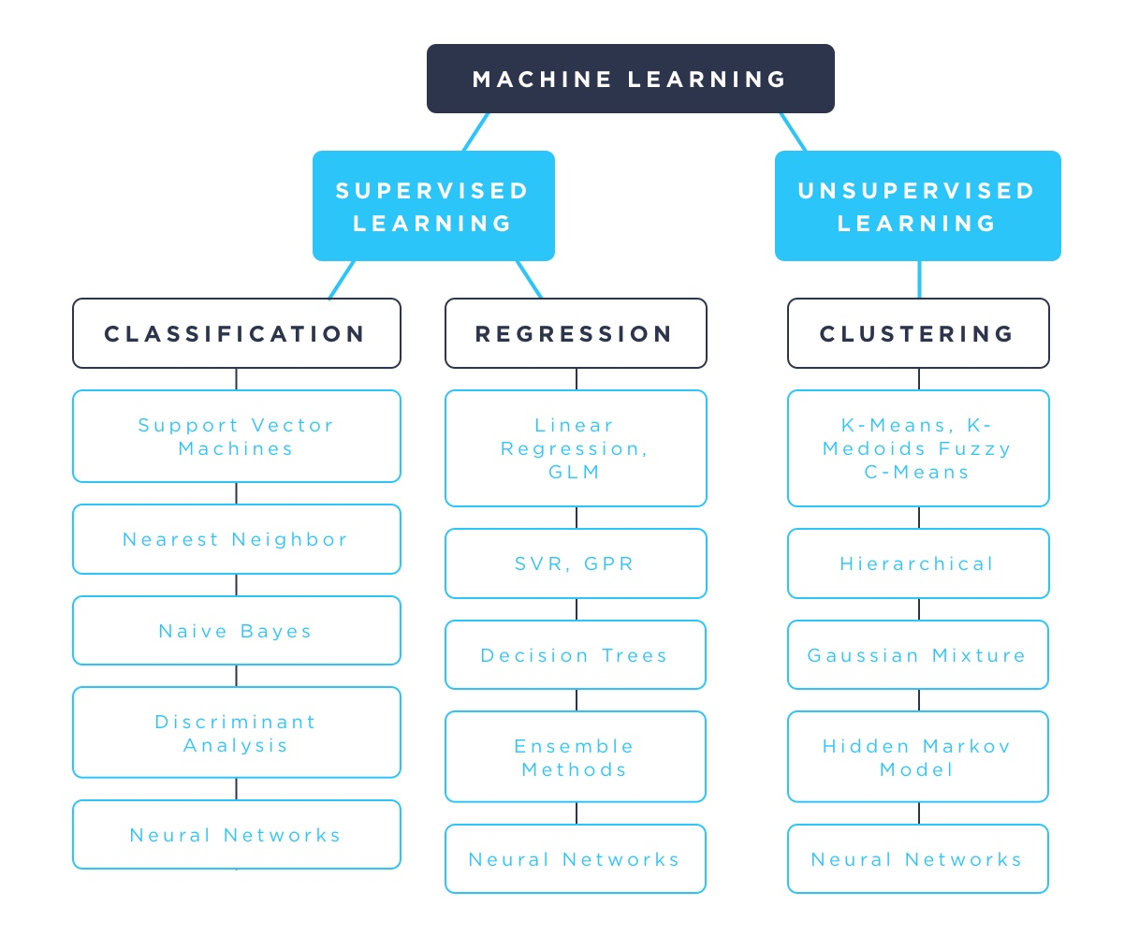
IRONHACK BOOTCAMP

Slide 5


Supervised Learning.

Slide 6
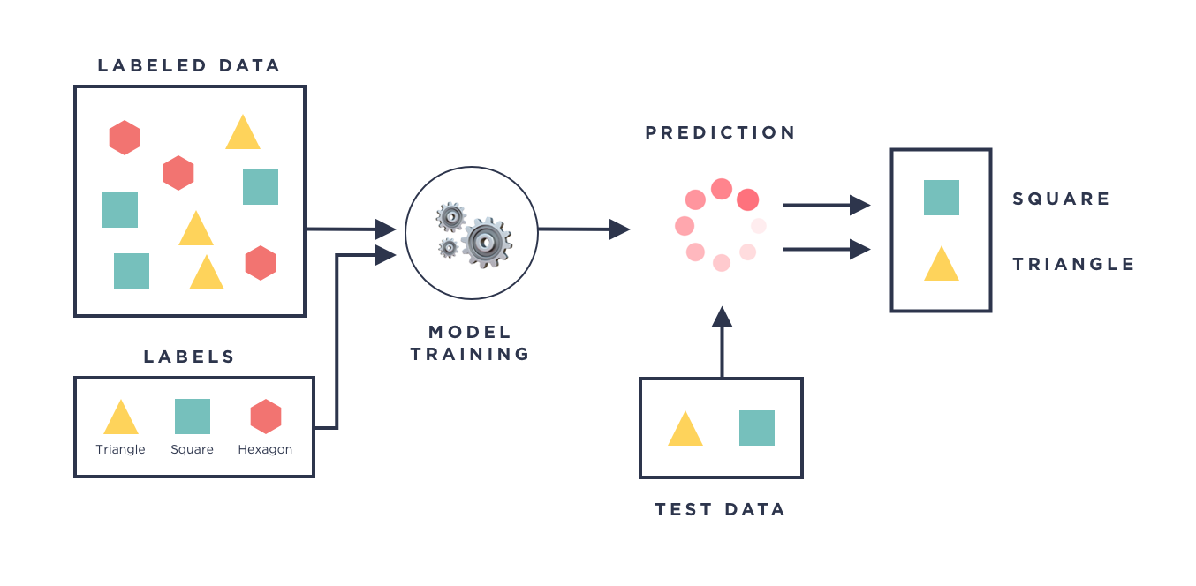
IRONHACK BOOTCAMP

Slide 7
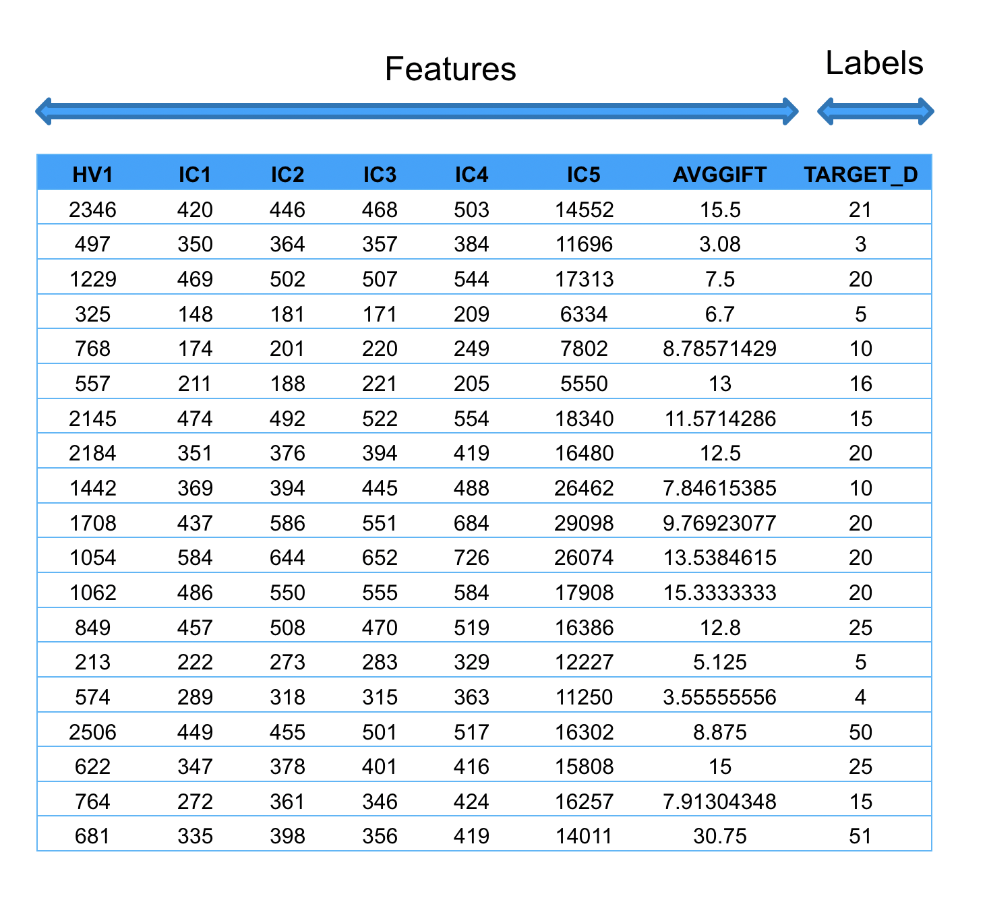
IRONHACK BOOTCAMP

Slide 8
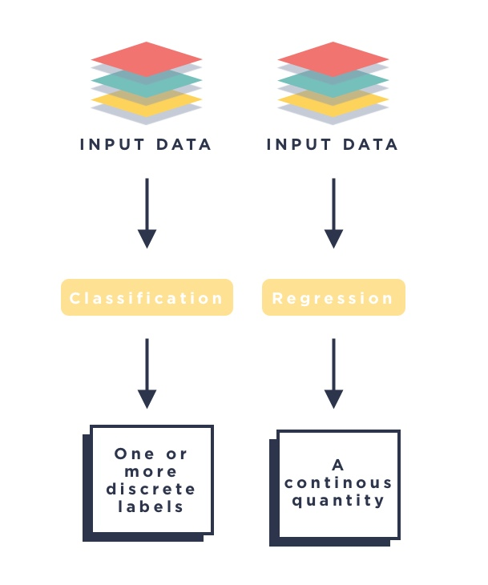
IRONHACK BOOTCAMP

Slide 9
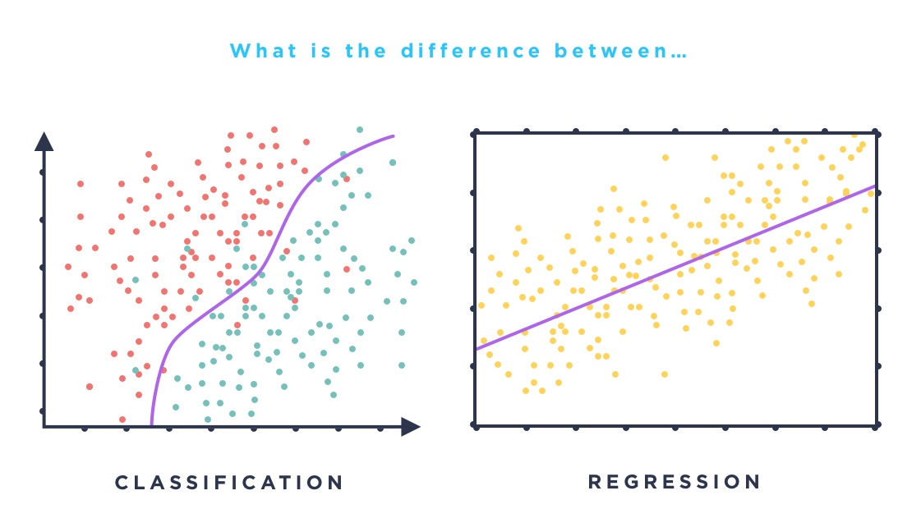
IRONHACK BOOTCAMP

Slide 10
Unsupervised Learning.

Slide 11
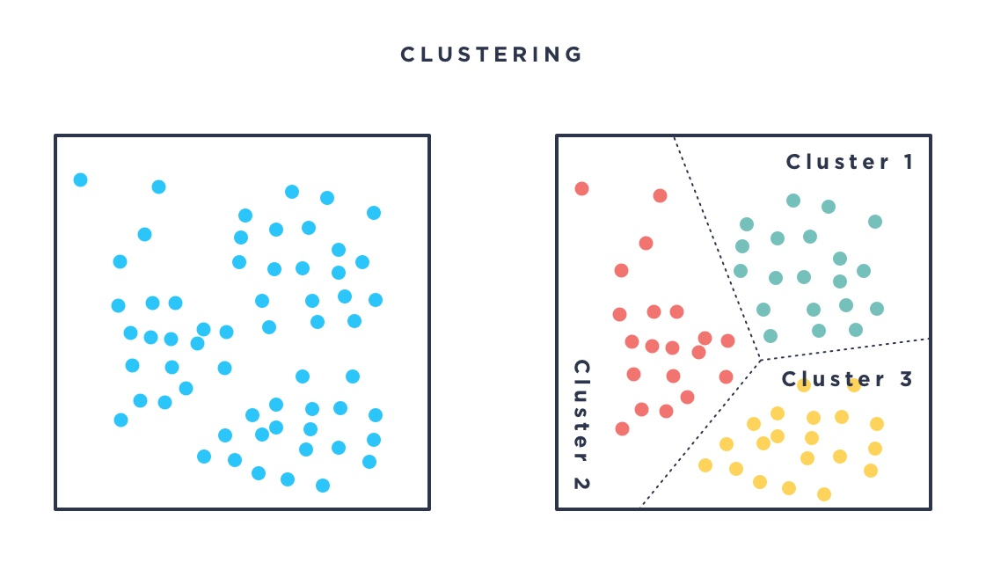
IRONHACK BOOTCAMP

Slide 12
Probability Revisit
DATA ANALYTICS | IRONHACK

Slide 13
IRONHACK BOOTCAMP
EVENTS AND PROBABILITY
Probability of an event = (# of ways it can happen) / (total number of outcomes)

Slide 14

IRONHACK BOOTCAMP
COMBINING PROBABILITIES
Two different events can be broadly classified as:
Joint -> They can happen together
Disjoint -> They can’t happen together
Notes:
I need to fix it

Slide 15
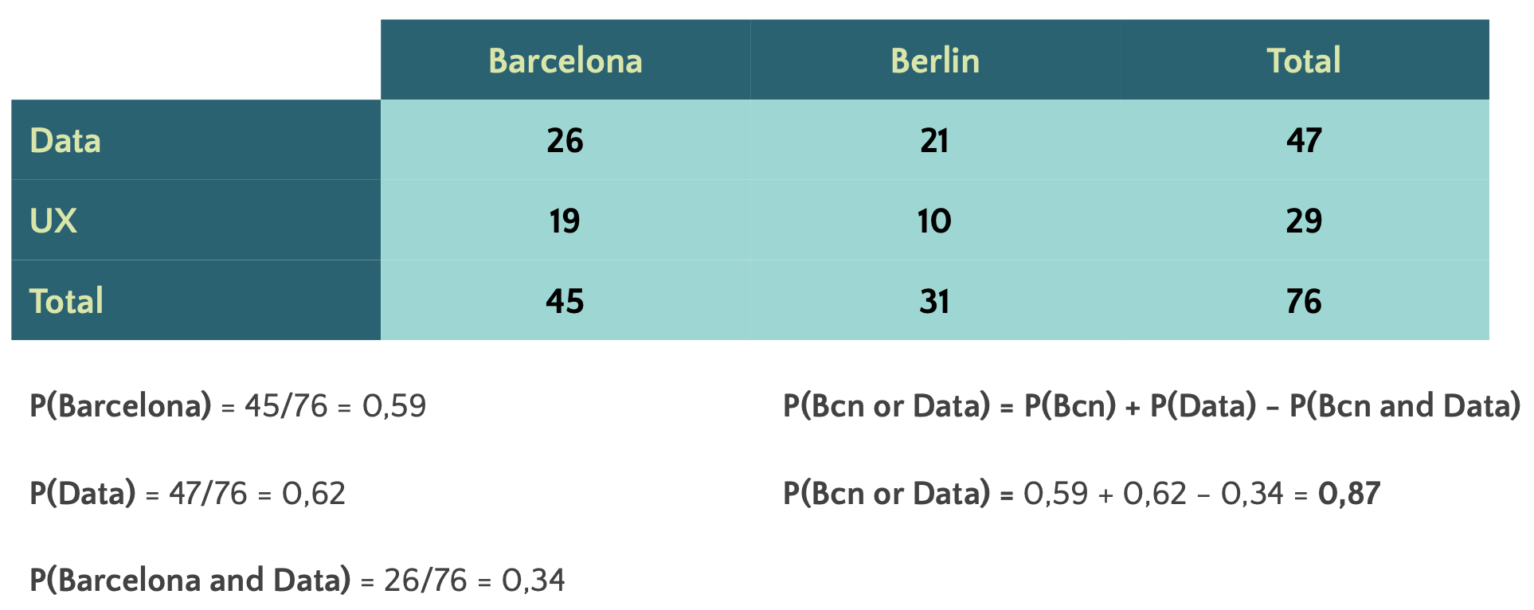
IRONHACK BOOTCAMP
EXAMPLES

Slide 16
Sampling
DATA ANALYTICS | IRONHACK

Slide 17
IRONHACK BOOTCAMP
POPULATIONS AND SAMPLES
A population is a COMPLETE collection of items/individuals/products
A sample is SUBSET of a population
Population
Sample

Slide 18



IRONHACK BOOTCAMP
POPULATION, SAMPLE AND COLLECTION OF SAMPLES
A population can be characterized by a distribution which will have:
A sample drawn from a population will be characterized by a sample mean (changes from sample to sample; is a random variable), and a sample standard deviation:
We can analyze what mean we will get if we compute the mean of the means of many collected samples from the population:

Slide 19

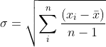
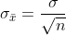
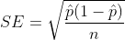
IRONHACK BOOTCAMP
CENTRAL LIMIT THEOREM AND SOME DEFINITIONS:
If the size of a sample n >= 30, the sampling distribution ( distribution of the means of many samples ) will follow a normal distribution, regardless of the original population distribution.
The standard deviation of the sample is:
The standard error of the mean (SEM) is:
For proportions the SE is defined as:

Slide 20
HOW TO CHARACTERIZE A SAMPLE/POPULATION
There are two types of measures to characterize a sample / population
Central tendency
Dispersion

Slide 21
IRONHACK BOOTCAMP
MEASURES OF CENTRAL TENDENCY
[1,2,2,4,6,8,50]
Mean: (1+2+2+4+6+8+50)/7 = 10.43 ( heavily affected by outliers)
Median: 4 ( unaffected by outliers )
Mode: 2

Slide 22
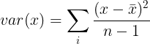
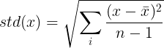
IRONHACK BOOTCAMP
MEASURE OF DISPERSION
VARIANCE AND STANDARD DEVIATION
Variance:
Standard deviation:
(we divide by n-1 to
avoid underestimating the
Standard deviation)
demo

Slide 23
Probability distributions
DATA ANALYTICS | IRONHACK

Slide 24
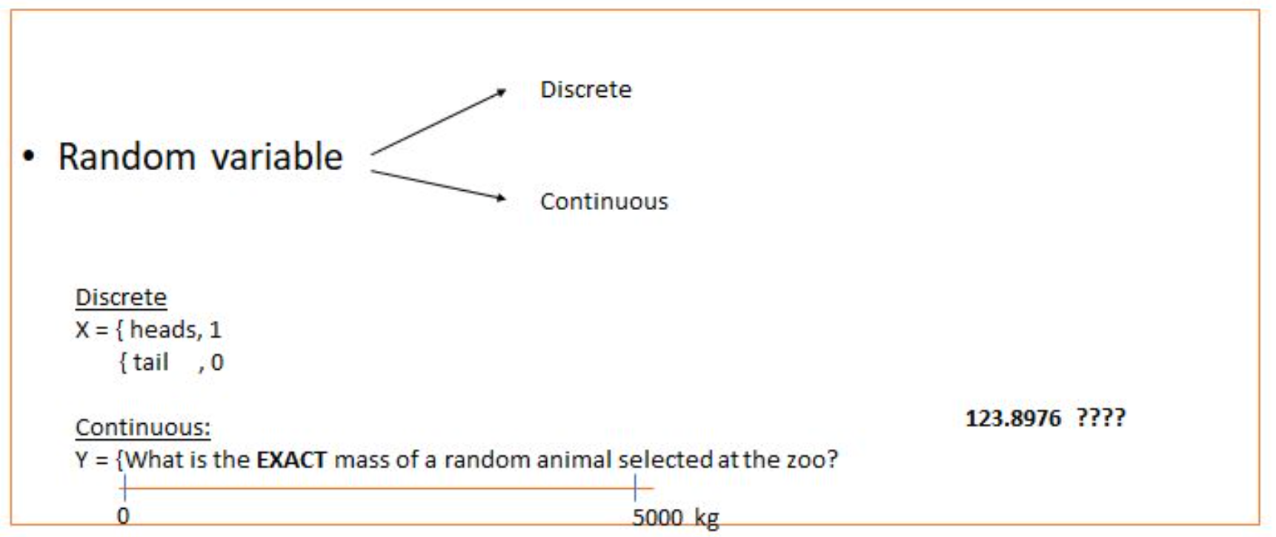
IRONHACK BOOTCAMP
RANDOM VARIABLES:

Slide 25
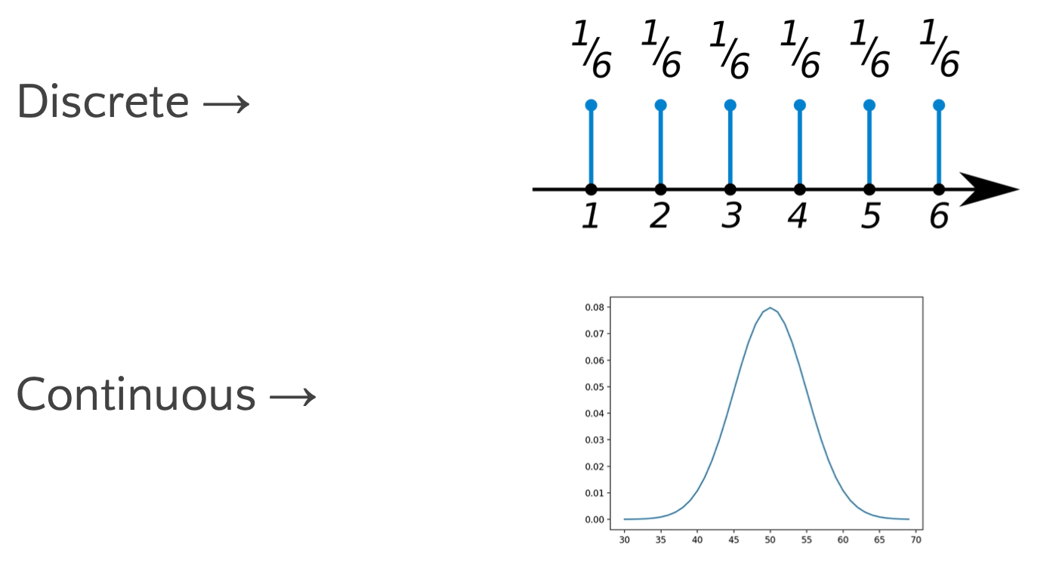
IRONHACK BOOTCAMP
PROBABILITY DISTRIBUTIONS:
Mathematical function that gives us the probabilities of occurrence of different outcomes.

Slide 26
IRONHACK BOOTCAMP
PMF: PROBABILITY MASS FUNCTION
Is a function that give us the probability that a DISCRETE random variable takes an specific value

Slide 27
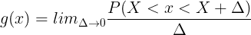
IRONHACK BOOTCAMP
PDF: PROBABILITY DENSITY FUNCTION
The PDF is the equivalent of PMF but for continuous variables.
As you can have an infinite amount of possible values between any two numbers, is not possible to define the probability for every value.
Therefore, we define a density of probability rather than the probability mass. The concept is very similar to mass density in physics: its unit is probability per unit length. To get a feeling for PDF, consider a continuous random variable X

Slide 28
IRONHACK BOOTCAMP
DISCRETE DISTRIBUTIONS: BERNOULLI DISTRIBUTION
A Bernoulli event is one for which the probability the event occurs is p and the probability the event does not occur is 1-p; i.e., the event only has two possible outcomes (usually viewed as success or failure) occurring with probability p and 1-p, respectively
Coin single launch example.

Slide 29


IRONHACK BOOTCAMP
DISCRETE DISTRIBUTIONS: BINOMIAL DISTRIBUTION
When”n” independent Bernoulli's experiments are conducted, it gives rise to a binomial distribution. Each of the n experiments is either a success or a failure with a probability of success p.
coin launched n times example with x heads.

Slide 30
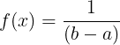
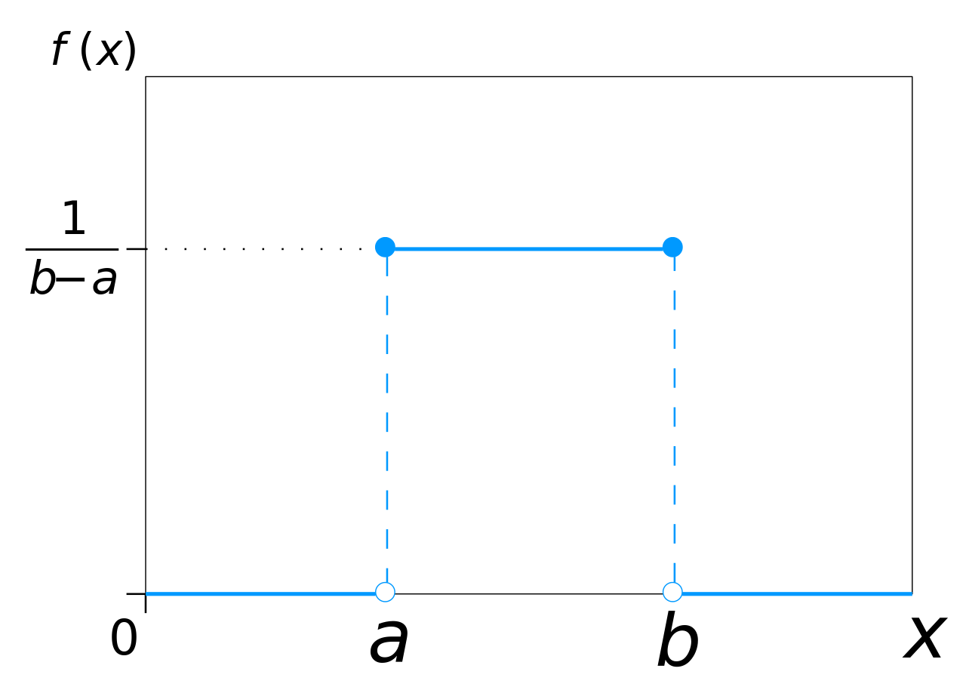
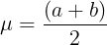
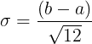
IRONHACK BOOTCAMP
CONTINUOUS DISTRIBUTIONS: UNIFORM DISTRIBUTION
For this distribution, all the values have the same probability to appear.
The uniform distribution is characterized by being constant:

Slide 31

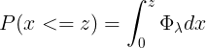
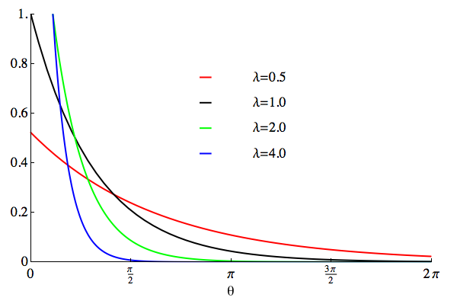
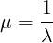
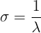
IRONHACK BOOTCAMP
CONTINUOUS DISTRIBUTIONS: EXPONENTIAL DISTRIBUTION
The exponential distribution has the following pdf:
It has the following range of values: [0,inf)

Slide 32
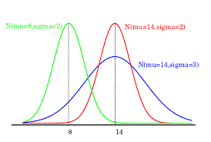
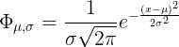
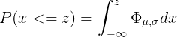
IRONHACK BOOTCAMP
NORMAL DISTRIBUTION
Continuous Distribution
The normal distribution is characterized by the mean and the standard deviation.
X can take values from (-inf,inf)

Slide 33

DATA Processing/ Transformation

Slide 34




Garbage in / Garbage out
A model prediction will never be better than your input data!

Slide 35
Data cleaning / wrangling
Standardize column names
Deleting and rearranging columns
Working with data types (set the correct type)
Filtering data
Removing duplicates
Collecting typos
Conditional formatting
Replace missing values
00

Slide 36



Independent vs dependent features/variables
Features:
In any dataset we can distinguish between two types of features/variables/columns:
Independent / predictive ( those that we will use to make predictions )
Dependent / Target ( WHAT want we want to predict USING the INDEPENDENT FEATURES )

Slide 37


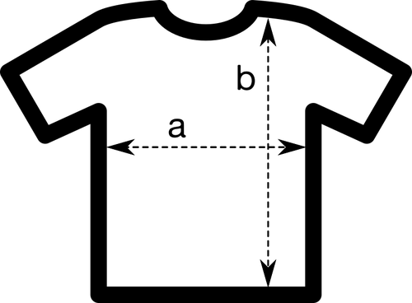
Types of features
Features:
There are always two types of features or variables:
Numerical: (numbers: 1, 2, 3…,3.15, 38.4)
Categorical (tags)
Ordinal ( they display some kind of order )
Nominal (they don’t have any order
Dates:
Usually we use date differences.
How we can distinguish between them?
Numericals express an amount (they can be added, subtracted, multiplied, divided..)
Categoricals doesn’t express an amount, express a tag.

Slide 38
IRONHACK BOOTCAMP
TRANSFORMING DATA: TRANSFORMERS
Collected data can be affected by:
Outliers
Small range
Skewness
All those problems will affect the predictive power of your model
You will need to transform the data to:
Improve interpretability
Declutter graphs
Discover relationships between variables

Slide 39
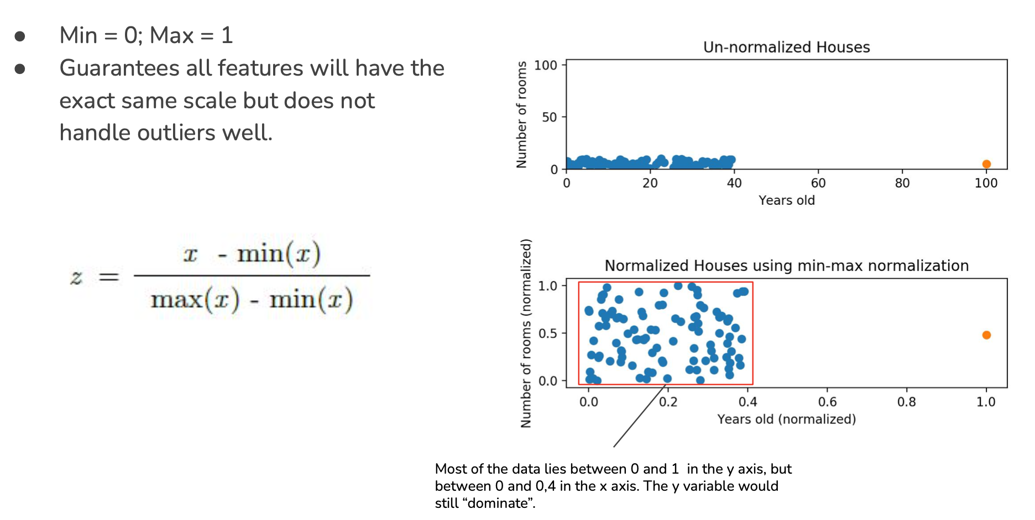
IRONHACK BOOTCAMP
MIN-MAX TRANSFORMER:
MinMaxScaler

Slide 40
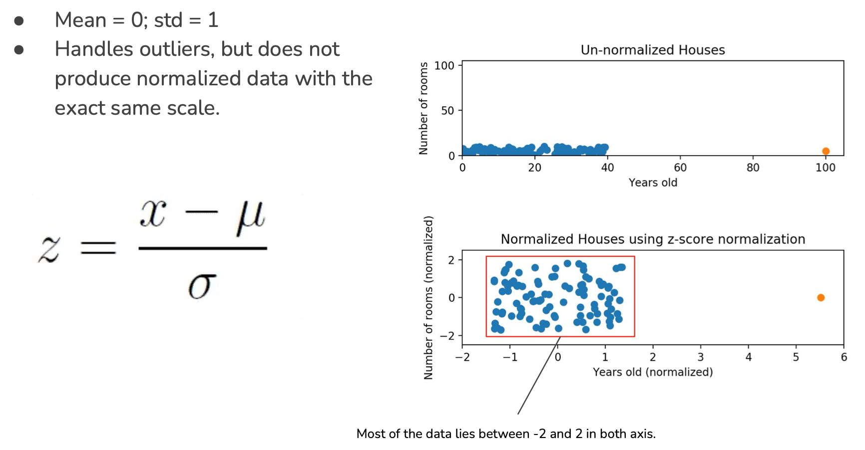
IRONHACK BOOTCAMP
STANDARDSCALER TRANSFORMER:
StandardScaler

Slide 41
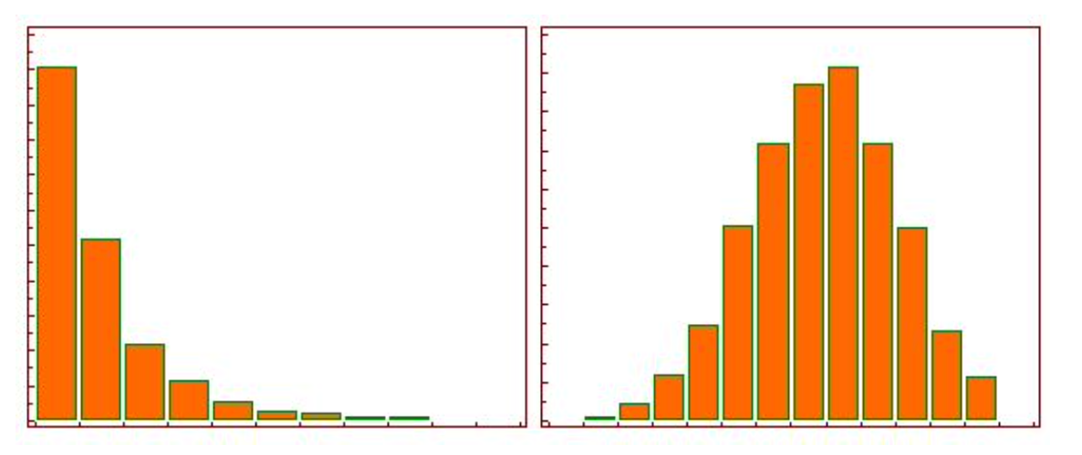
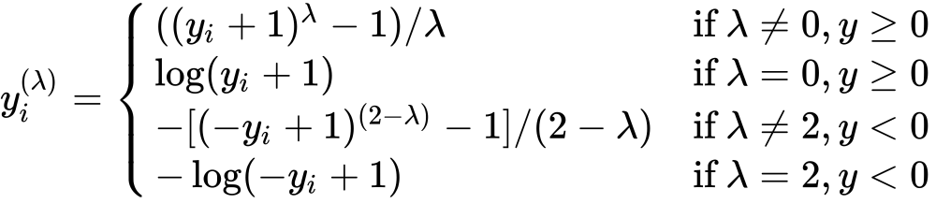
IRONHACK BOOTCAMP
POWER TRANSFORMER:
PowerTransformer
Replaces the values in each column in order to end up with a new distribution with the smallest skewness.
Depends on a parameter called “lambda” to be determined for each sample.

Slide 42

Encoding data
Numerical
Features
Nominals
One Hot Encoding
Categoricals
Ordinals encoding
Ordinals

Slide 43
One Hot Encoding
Consists in getting an dataframe of binary entries for each value of the categorical column.
Color
Red
Green
Blue
Red | Green | Blue
1 | 0 | 0
0 | 1 | 0
0 | 0 | 1
Pros: Easy to automate. Cons: Increases the number of columns

Slide 44
Ordinal Encoding
Consists in assigning numerical values to each unique value of the categorical column according to an “implicit” relative ordering
Educational level | Value
Analphabet | 0
Primary School | 1
High School | 2
Bsc | 3
Ph.D. | 4

Slide 45
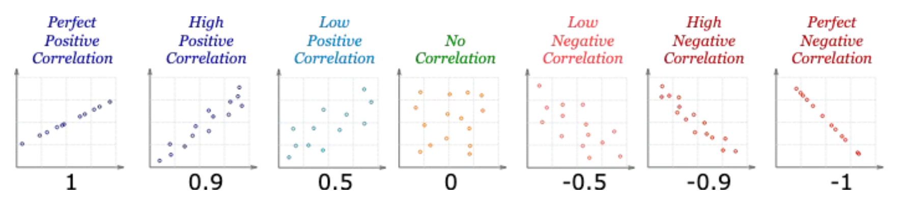
IRONHACK BOOTCAMP
Checking for Correlation
The correlations quantifies how much linearly related are two numerical variables.
The correlation coefficient can be positive, negative or null
The range of values is: -1, 1
Dropping one of the features with high correlation between them.

Slide 46
IRONHACK BOOTCAMP

Slide 47
LINEAR REGRESSION

Slide 48

Introduction to linear regression
Do you remember the two types of variables / features? ( Numerical and Categorical? )
Now is when this distinction makes sense as we can have two types of problems in supervised learning:
Regression: (prediction of a numerical feature)
Classification (prediction of a categorical feature)
Supervised learning

Slide 49
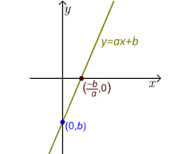
Introduction to machine learning
A linear regression model is a supervised parametric model ( it’s based on a given formula ) which has two parameters:
Slope (a)
Intercept (b)
A linear model can have multiple independent features.
Linear regression model

Slide 50
Introduction to machine learning
A linear regression model is one particular type of regression which is making the following four assumptions about the data:
Lineality ( the relation between the independent feature and the dependent feature is linear )
Independency: every observation used to train the model doesn’t depend of another.
Normality: all the variables (independent and dependent) are normally distributed.
Normality of errors made by model’s predictions are fairly constant
Linear regression assumptions

Slide 51
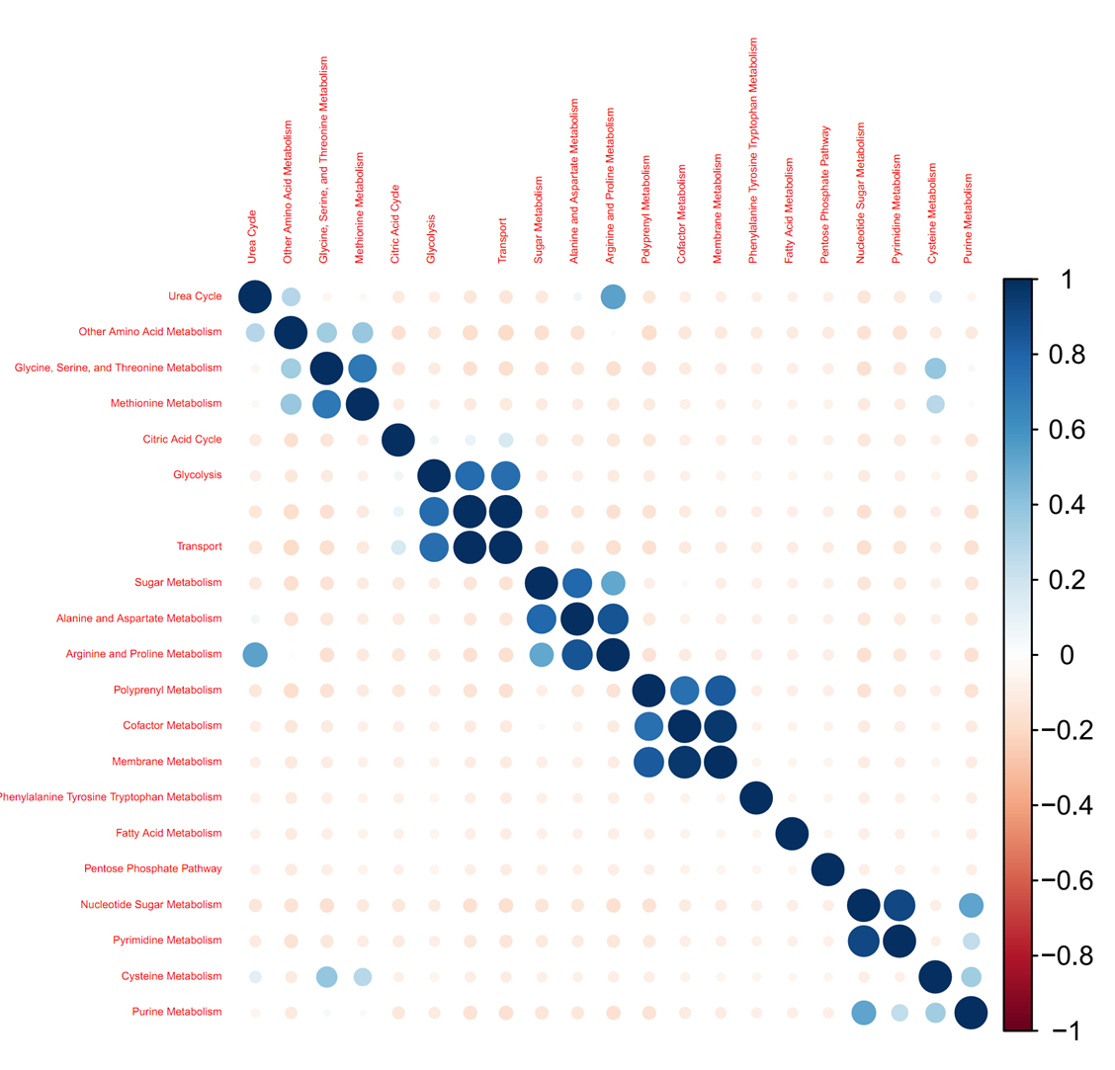
Introduction to machine learning
To check the linearity of the relationship between the dependent feature and the independent feature, check: correlation matrix.
The higher ( in absolute value ) the value of the correlation, the better. A minimum to consider a good correlation value is 0.75, but there is no consensus.
Checking for linearity: correlation matrix

Slide 52
Introduction to machine learning
Plot the distribution of each variable and check out if resembles a normal distribution.
If not, fit and apply a transformer/scaler:
power= PowerTransformer()
power.fit(X_train)
power.transform(X_train)
power.transform(X_test)
If you want to be picky checking for normality of a variable, you can use an statistical test like the: Shapiro-Wilks
Checking for normality

Slide 53
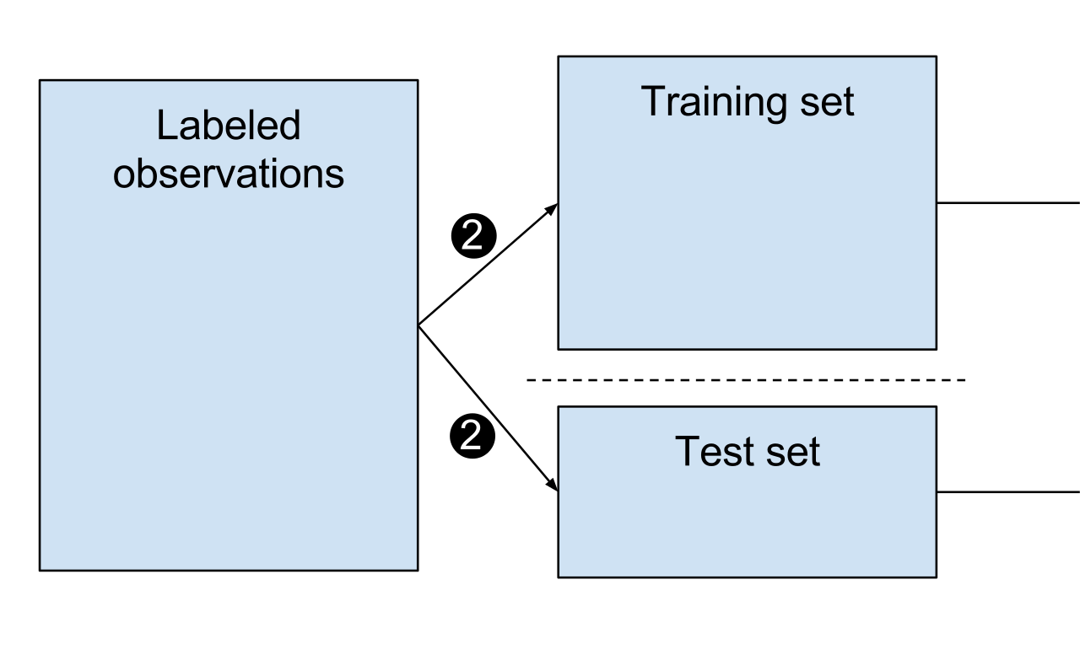
Data splitting and model selection
Split our original data in two sets:
Train and test sets:
Train set: 70-80% of the total data
Test set: 30-20% of the total data
How we decide in which set we place each row of our dataset?
Mostly at random except some specific situations
Now you train the model using the “train set” and you make predictions on the “test set”
Then you select the best model based on the best performance on the “test set”
trans.fit(x_train)
trans.transform(x_train)
model.fit(x_train,y_train)
trans.transform(x_test)
model.predict(x_test)

Slide 54
Data splitting and model selection
Using sklearn to perform data splitting and model generation:
from sklearn.model_selection import train_test_split
from sklearn.linear_model import LinearRegression
X_train, X_test, y_train, y_test = train_test_split(X, Y, test_size=0.3, random_state=100)
lm = LinearRegression() # fit_intercept = True
model = lm.fit(X_train,y_train)
predictions = model.predict(X_test)
model.coef_
model.intercept_

Slide 55

Introduction to machine learning
A linear model can have multiple independent features.
Multiple Linear regression model

Slide 56
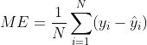
OLS
To answer this question, we need to think about how we quantify the error made by the model
If the model is perfect, the predictions are going to match the real values right?
Therefore, a first tentative can be to add the differences between the real values and the predicted ones:
WARNING!!! This is dangerous, we can have error compensation!!
How to determine the coefficients of a linear model (I)?

Slide 57
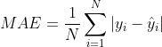
OLS
Then we need to get rid of the sign of the sign of the individual errors.
In other words, we want that all error contribute to the total error. Then, one possibility can be to take the absolute value:
However, this metric is problematic when determining the coefficients.
We need to consider another metric
How to determine the coefficients of a linear model (II)?

Slide 58
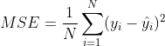
OLS
Another way to get rid of the sign of the individual errors is by means of the square:
This looks more feasible to minimize.
How to determine the coefficients of a linear model (II)?

Slide 59

OLS
In order to determine the optimal values for the linear model, this method makes MSE becomes minimum:
Ordinary least square method (OLS)

Slide 60
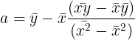
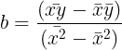
OLS
According to this method the values for the linear model are:
Ordinary least square method (OLS)

Slide 61
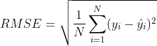
Error metrics in regression models
Metrics:
Sklearn mean absolute error
Sklearn mean squared error
Mean error:
It can suffer from error compensation.
The closer to zero, the better
Mean absolute error:
Not easy to minimize
The smaller the better
Mean squared error:
Easy to minimize
The smaller the better
Too sensitive to outliers in predictions
Squared units!
Root mean square error:
Not easy to minimize
The smaller the better
To sensitive to outliers in predictions
Correct units!

Slide 62
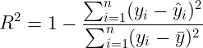
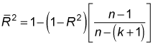
Error metrics in regression models
Metrics:
R2:
Provides a measurement of the “explanatory” power of a model (shows how much variance of y can be explained by the independent features)
Compares the variance of your model’s errors against the “mean model” (model for which all the predictions are the mean of the dependent variable)
Increases with every independent feature you add
Provides a way to compare the performance of several models
Adjusted R2:
Provides a measurement of the “explanatory” power of a model taking into account the number of independent features used by the model.
Only increases if the inclusion of a new feature improves the model’s performance.
Sklearn r2

Slide 63
Where to evaluate the error metrics?
Evaluate the error metrics in:
Train set
Test set
Compare the error metrics in both sets:
If error_train very high -> Underfitting ( consider other model or to add more variables)
If error_train <= error_test -> Ok
If error_train very small and <<<< error_test -> Overfitting!!!! ( you overtrained your model or you did not applied the transformer to the test set ).

Slide 64
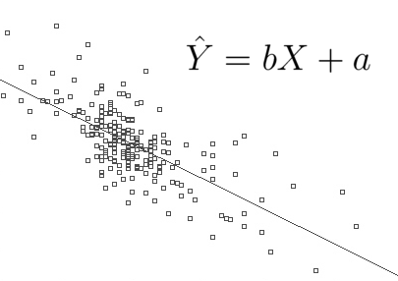
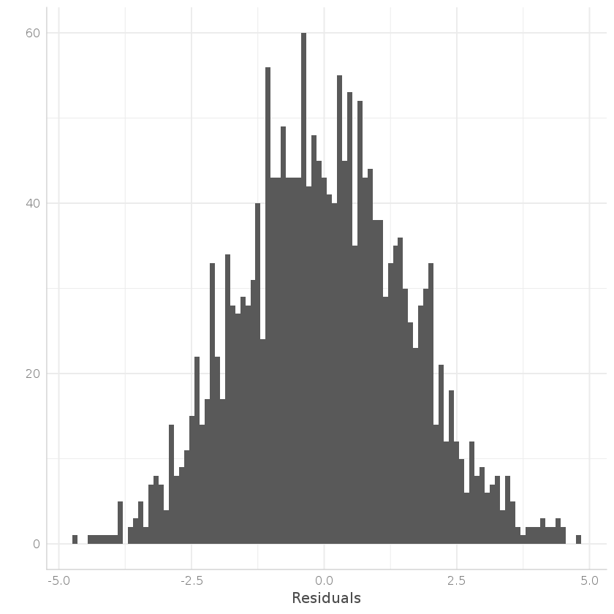
Analyzing your model
Make a scatter plot of the predicted values against the real values. In a perfect model, the predicted values match the real values, therefore you should see an straight line.
Pot the distribution of the residuals (real_value - predicted_value) they should look normally distributed. Deviations from normality means average over/under estimation.

Slide 65
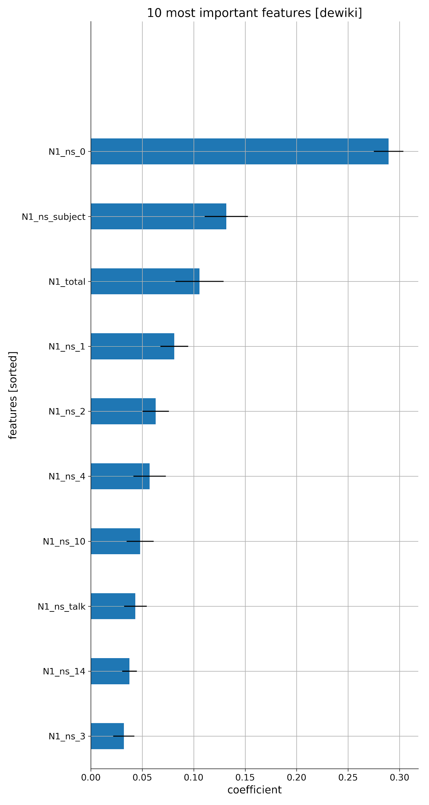
Feature importance
In order to check which independent features are more relevant to your model, compare the absolute value of each coefficient.
Only valid if all the features are in the same scale.

Slide 66
Tableau interface
DATA ANALYTICS | IRONHACK

Slide 67
IRONHACK BOOTCAMP
IMPORTING FILES, connecting to a Data source.
SHEETS, DASHBOARDS AND STORIES

Slide 68
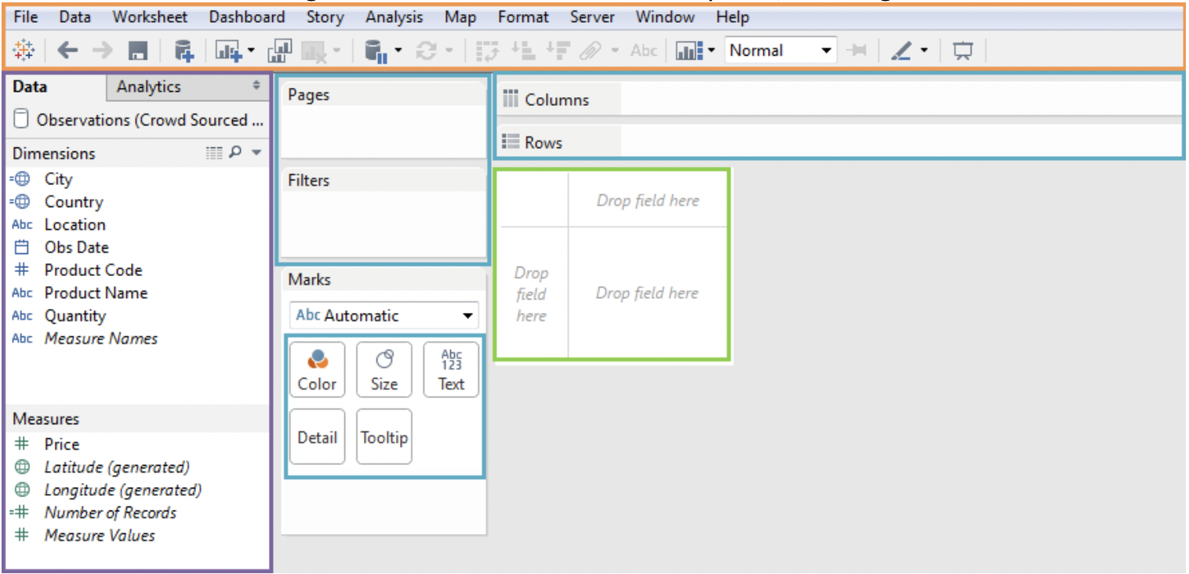
DATA WINDOW
Fields are split into:
Dimensions (splittable)
Measures (amount)
Geographicals

Slide 69
IRONHACK BOOTCAMP
DIMENSIONS
They are typically “categorical” columns that you can use to “split” the data.
MEASURES
They are typically “numerical” columns. :
Numerical values
Averages
Counts
Sums….

Slide 70
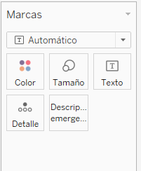
IRONHACK BOOTCAMP
MARKS
They allow you to control the display of a graph:
Color
Size
Text…
They also allow you to add additional features.

Slide 71
FILTERS
Drag and drop the variable you want to filter to the pane: “Filters”
NOTES
Right click on an empty espace on the canvas to add a note.
TITLES
Right click on the canvas name.

Slide 72
SHOW ME TAB
On the top right, you should see the “Show me” tab which allows you to
Select the type of visualization you want.
The dimensions and measurements that you have in the canvas determine the available plots.
It also tell you what you need in order to build the visualization:
Dimensions
Measurements

Slide 73
SCATTER PLOTS
Drag and drop the variable you want to be displayed on the ‘y’ axis in the
“Columns” toolbar.
Drag and drop the variable you want to be displayed on the ‘X’ axis in the
“Rows” toolbar.
Go to the menu and select Analysis and uncheck “Aggregate Measures”

Slide 74
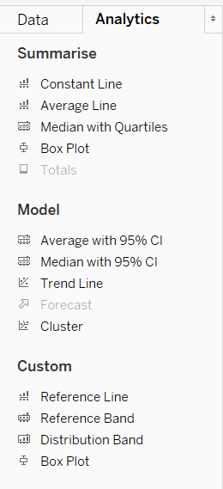
ANALYTICS TAB
On the “Data panel” there is another tab called “Analytics” which contains options to add trend lines.

Slide 75
Tableau Chart Types

Slide 76

IRONHACK BOOTCAMP
SCATTER PLOTS
They are useful to show the relationship between two numerical variables.

Slide 77

IRONHACK BOOTCAMP
LINE PLOTS
They are used when we want to plot continuous data ( time evolution )
They can contain:
Single series
Two series
Multiple series

Slide 78

IRONHACK BOOTCAMP
BAR PLOTS
Used to show quantities for categorical data.
Be careful to show a zero baseline!

Slide 79
IRONHACK BOOTCAMP
TEXT
Text tags can reinforce the message.
85%
employment rate

Slide 80

IRONHACK BOOTCAMP
Pie Chart

Slide 81

IRONHACK BOOTCAMP
USE CONTRAST TO FOCUS THE ATTENTION

Slide 82
Tableau Table Calculations

Slide 83
IRONHACK BOOTCAMP
QUICK TABLE CALCULATION
They are quick types of calculations that can be performed on a measurement of a view/plot (instead of the usual aggregation function).
They are not stored, they are just used and displayed.

Slide 84
IRONHACK BOOTCAMP
TABLE CALCULATIONS
They are calculations which can be stored -> equivalent to add a new column to the data.
They are computed creating a new “calculated field”.
On the drop down menu of the measurement select “Table calculation”.
Set:
“Calculation Type” to the “Percentage of total”.
“Compute Using” to “Specific Dimensions” and check “process step”
“Relative to” to “Start”

Slide 85
IRONHACK BOOTCAMP
BINNIG
There are three ways of creating bins:
Using the “create bin” option.
Using IF-ELSE
Group

